Slide 1
The Last One

Slide 2
I am Raag and I’m a member of The Last One.

Slide 3
This is me
Stand Here

Slide 4
Technically S.P.a.A.R.K(But that doesn’t sound good)

Slide 5
Signal Presence and Area Reconnaissance Kit

Slide 6
I designed Spark to be a tool people can use to know of any digital presence around them.

Slide 7
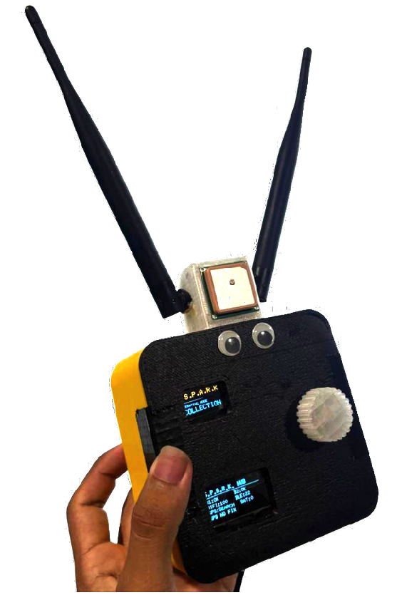
This is S.P.A.R.K
The accessible and easy to build project that allows anyone to locate signal presence around them.

Slide 8
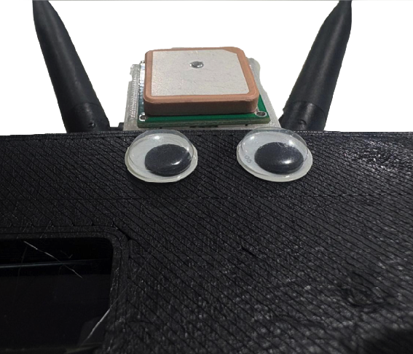
And he works on a simple and single assumption: People carry a signal emitting devices.

Slide 9
S.P.A.R.K is configurable, down gradable and upgradable based on requirement of the user preference and situations that might arise. And I envision him to be fully community owned and adored.

Slide 10
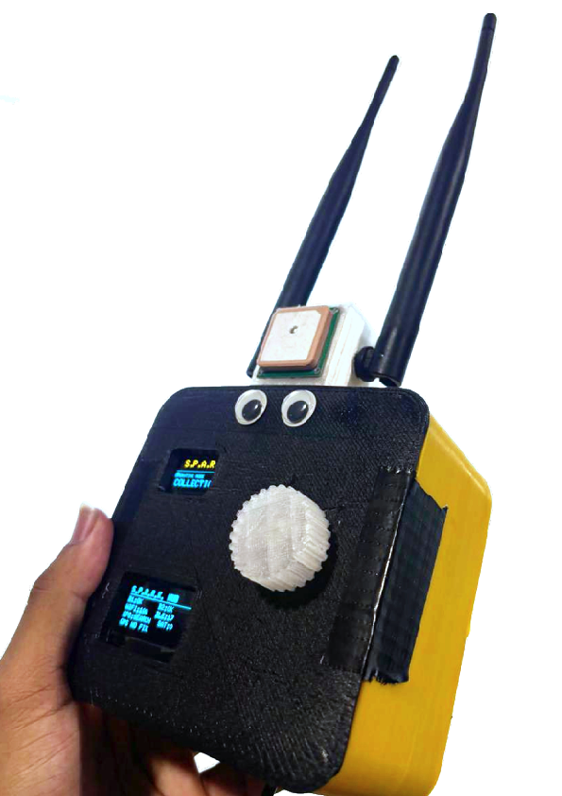
Here are some examples. (I haven’t made more than one so creative liberties were taken)
Exhibit 1 : Spark with longer and better antenna for better reach.
Exhibit 4 : Colorful Sparks.
Exhibit 2 : Small Spark with a small carriable and low energy consumption model for better battery life but low coverage.
Exhibit 3 : Wide Spark with a BIG power solutions.

Slide 11
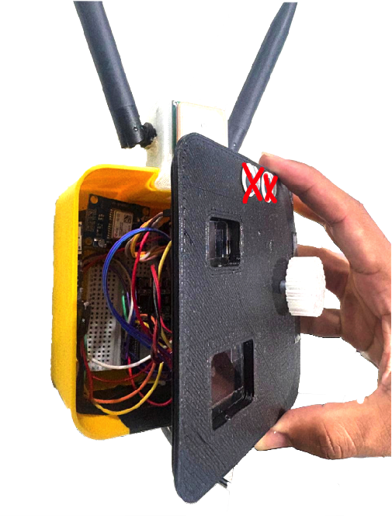
Now let’s look inside my Spark to see how he functions.

Slide 12
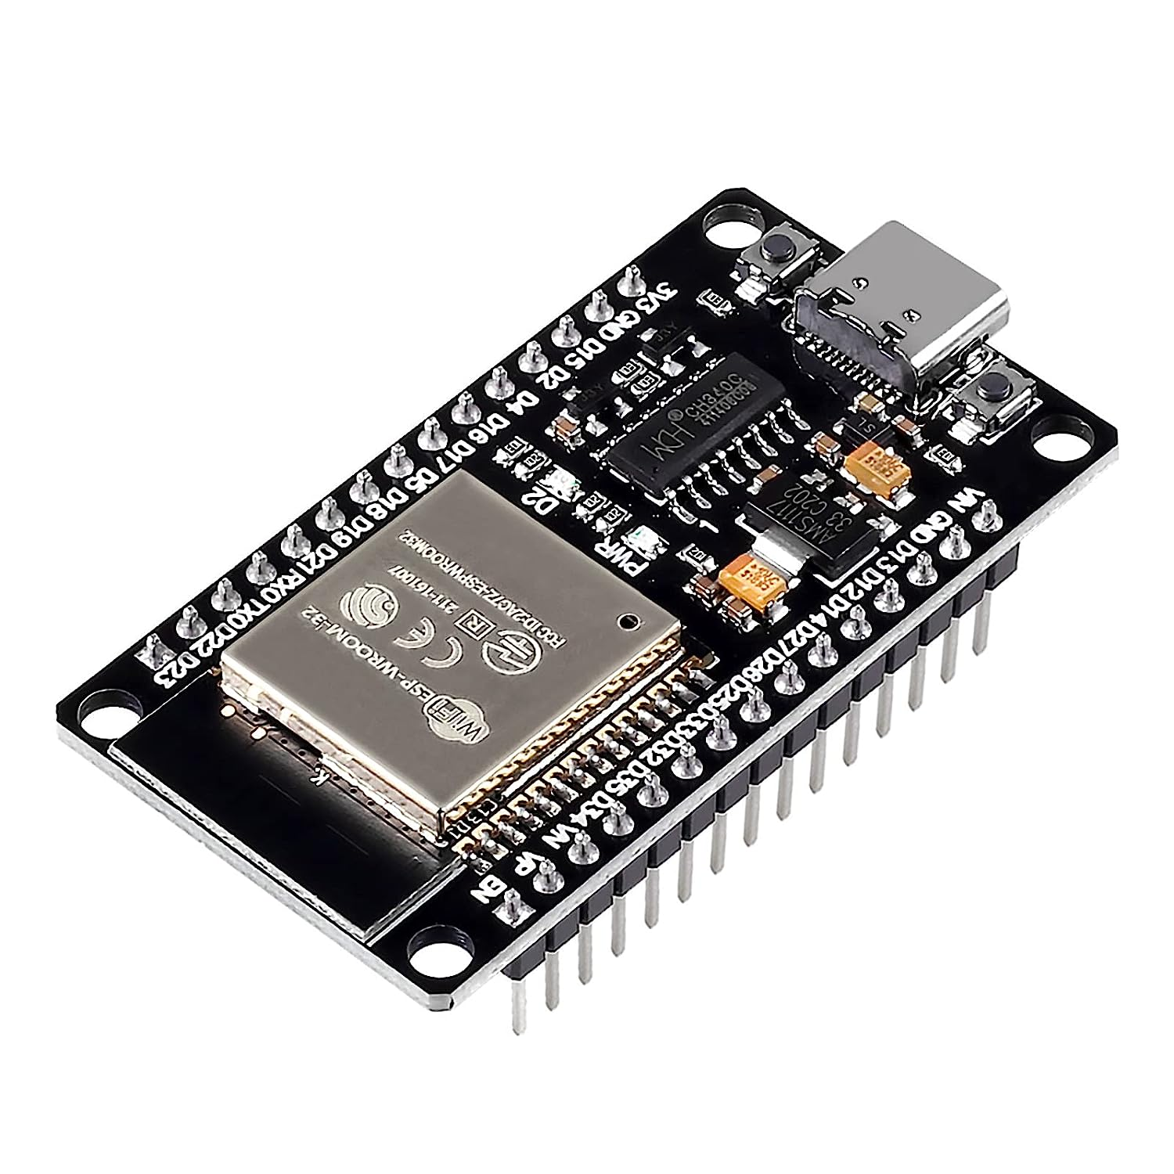
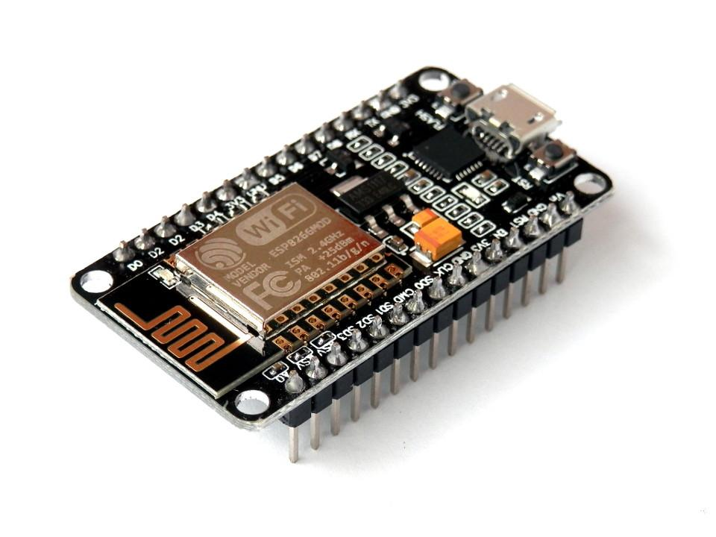
ESP 8266 dev board
ESP 32 dev board (Main board)
To retrieve Wifi Packets only and send it to the main board
To retrieve Bluetooth packets and host spark’s web app
Image: From engineersgarage.com
Image : From rees52.com

Slide 13
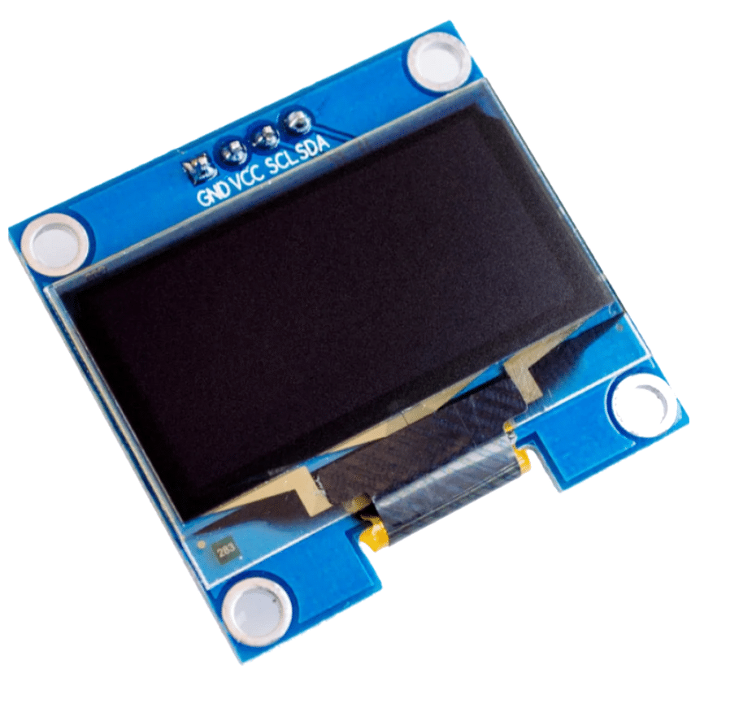
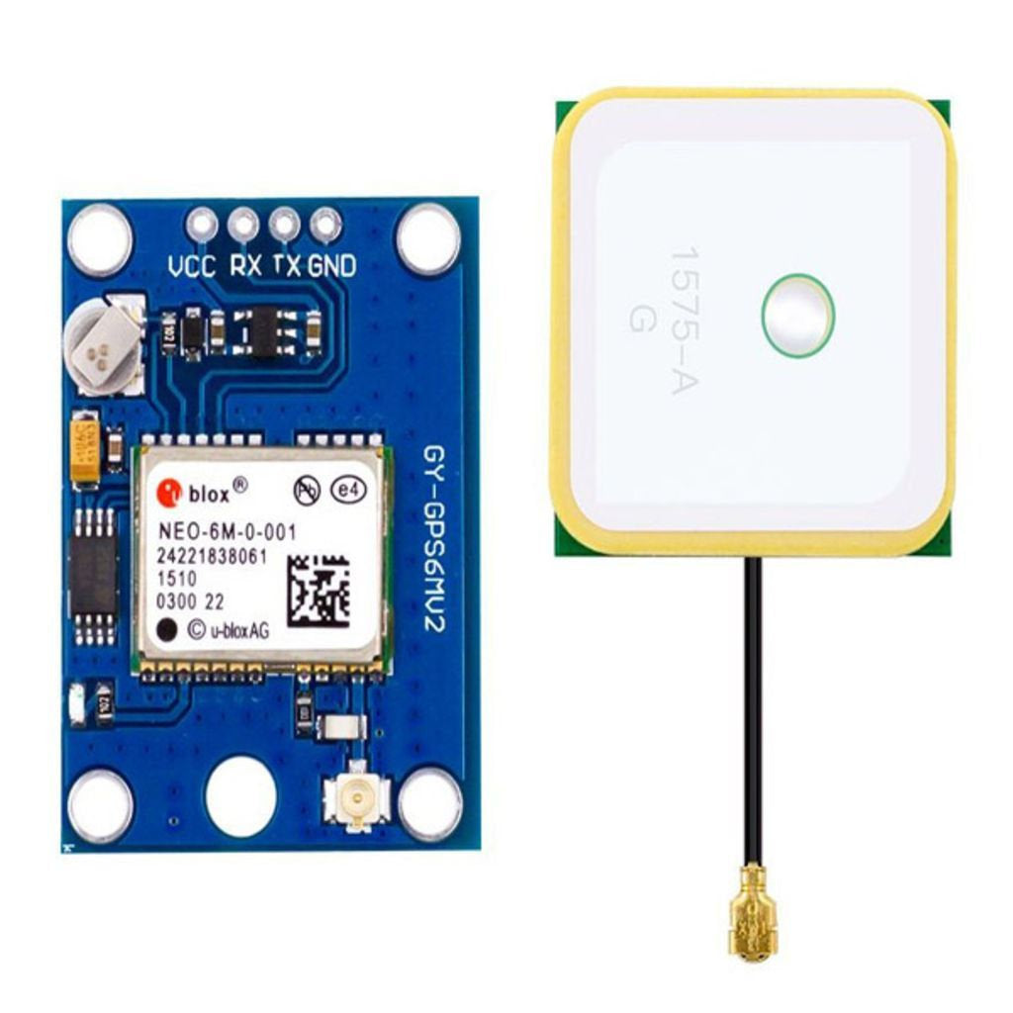
NEO 6m GPS module.
OLED screen
To show us what Spark is doing
For GPS
Image: From bec-lb.com
Image : From lk-tronics.com

Slide 14
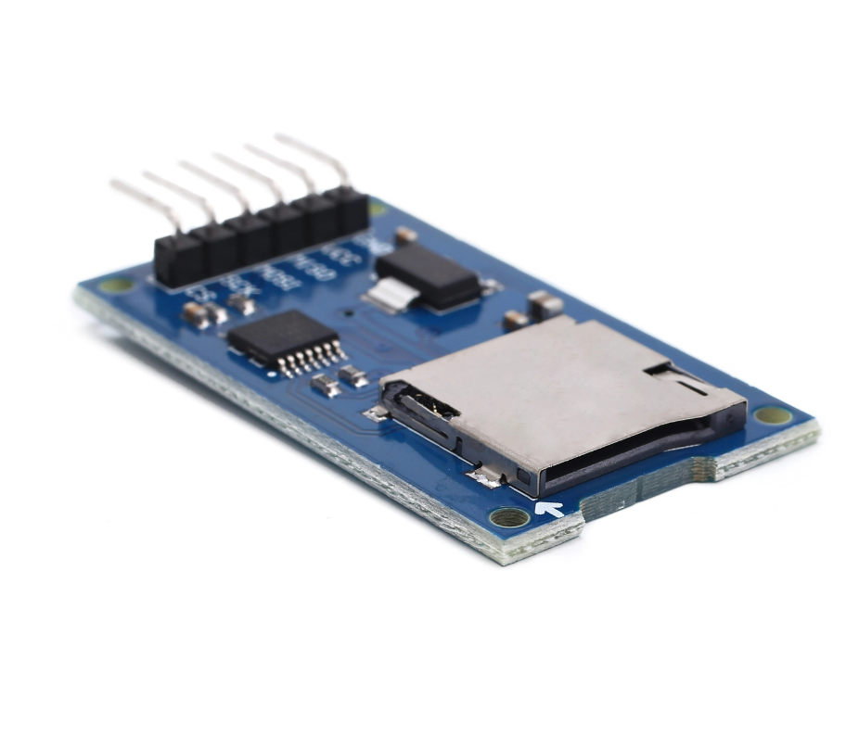
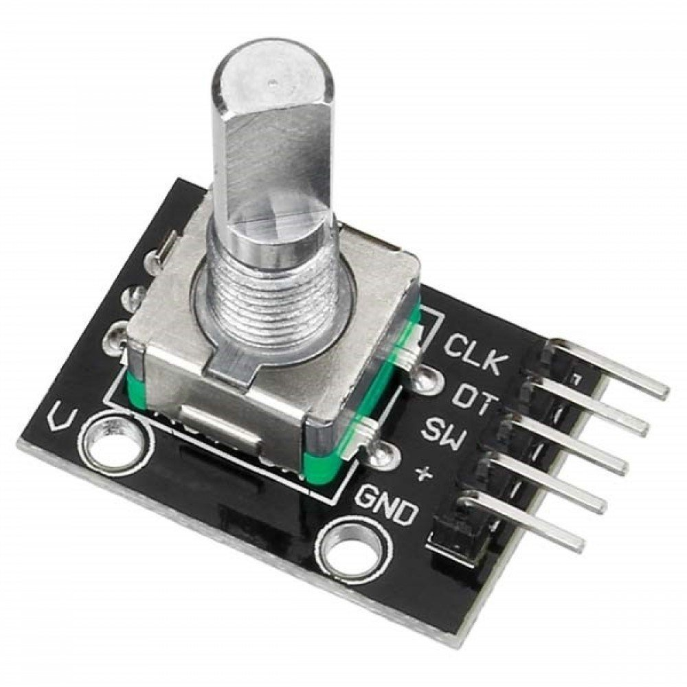
SD card module with an SD card.
Rotary Encoder So we can tell Spark when to switch modes
So Spark remembers what we sniffed
Image: From Alibaba.com
Image : From hepsiburada.com

Slide 15
My Spark was made with two modes
COLLECTION MODE
WEBSERVER MODE
To collect it’s GPS coordinates, nearby wifi packets, Bluetooth packets and save it in his storage.
Hosts a webserver to allow download of collected data by him.

Slide 16
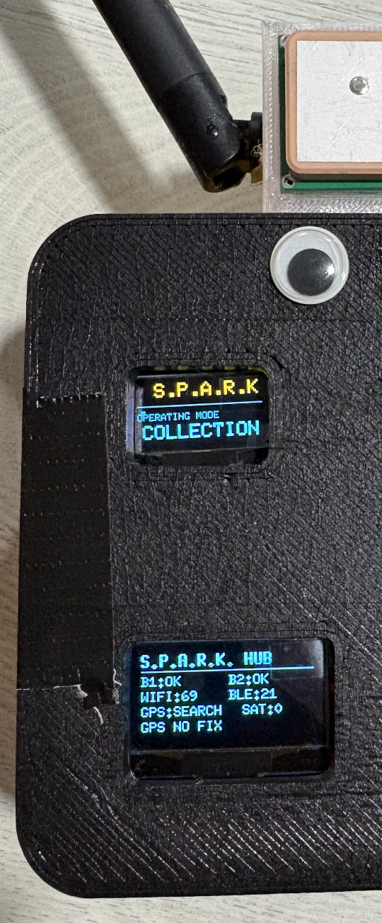
COLLECTION MODE
He shows you his most recent sniffs as well as alert you of the number of satellite looking up on him.

Slide 17
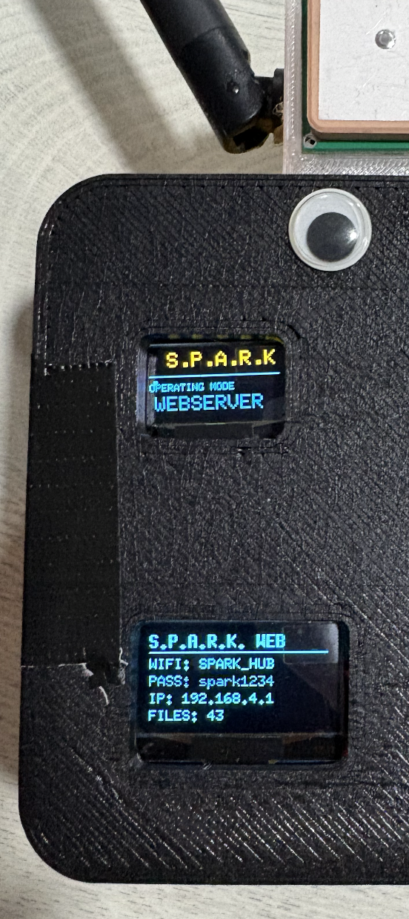
WEBSERVER MODE
He shows you a way to connect and also which IP to go to access his sniffs.

Slide 18
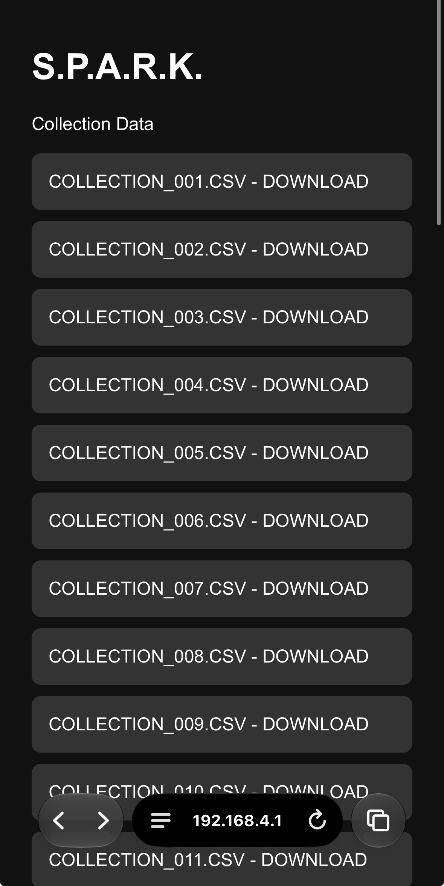
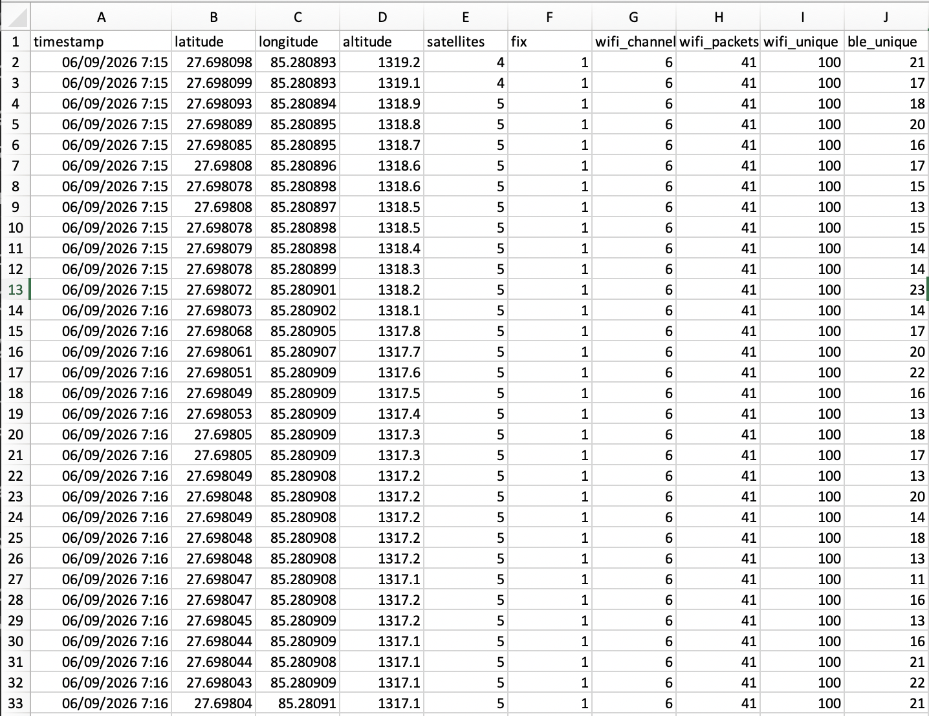

Slide 19
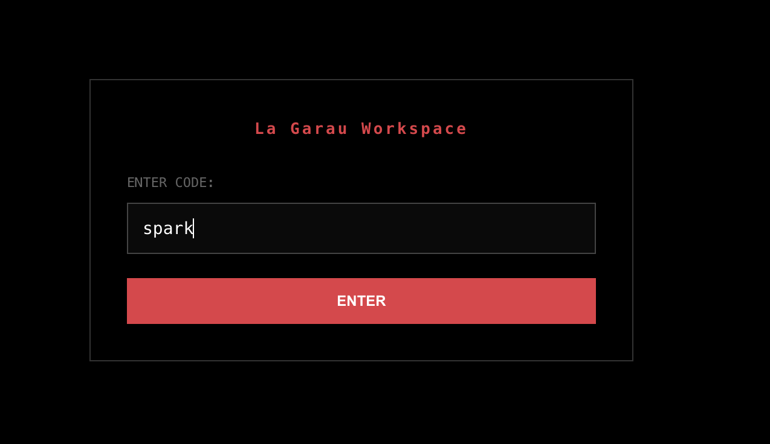
To see Sparky’s Demo in action Go to
Lagarau.com/portal Code : sparky

Slide 20
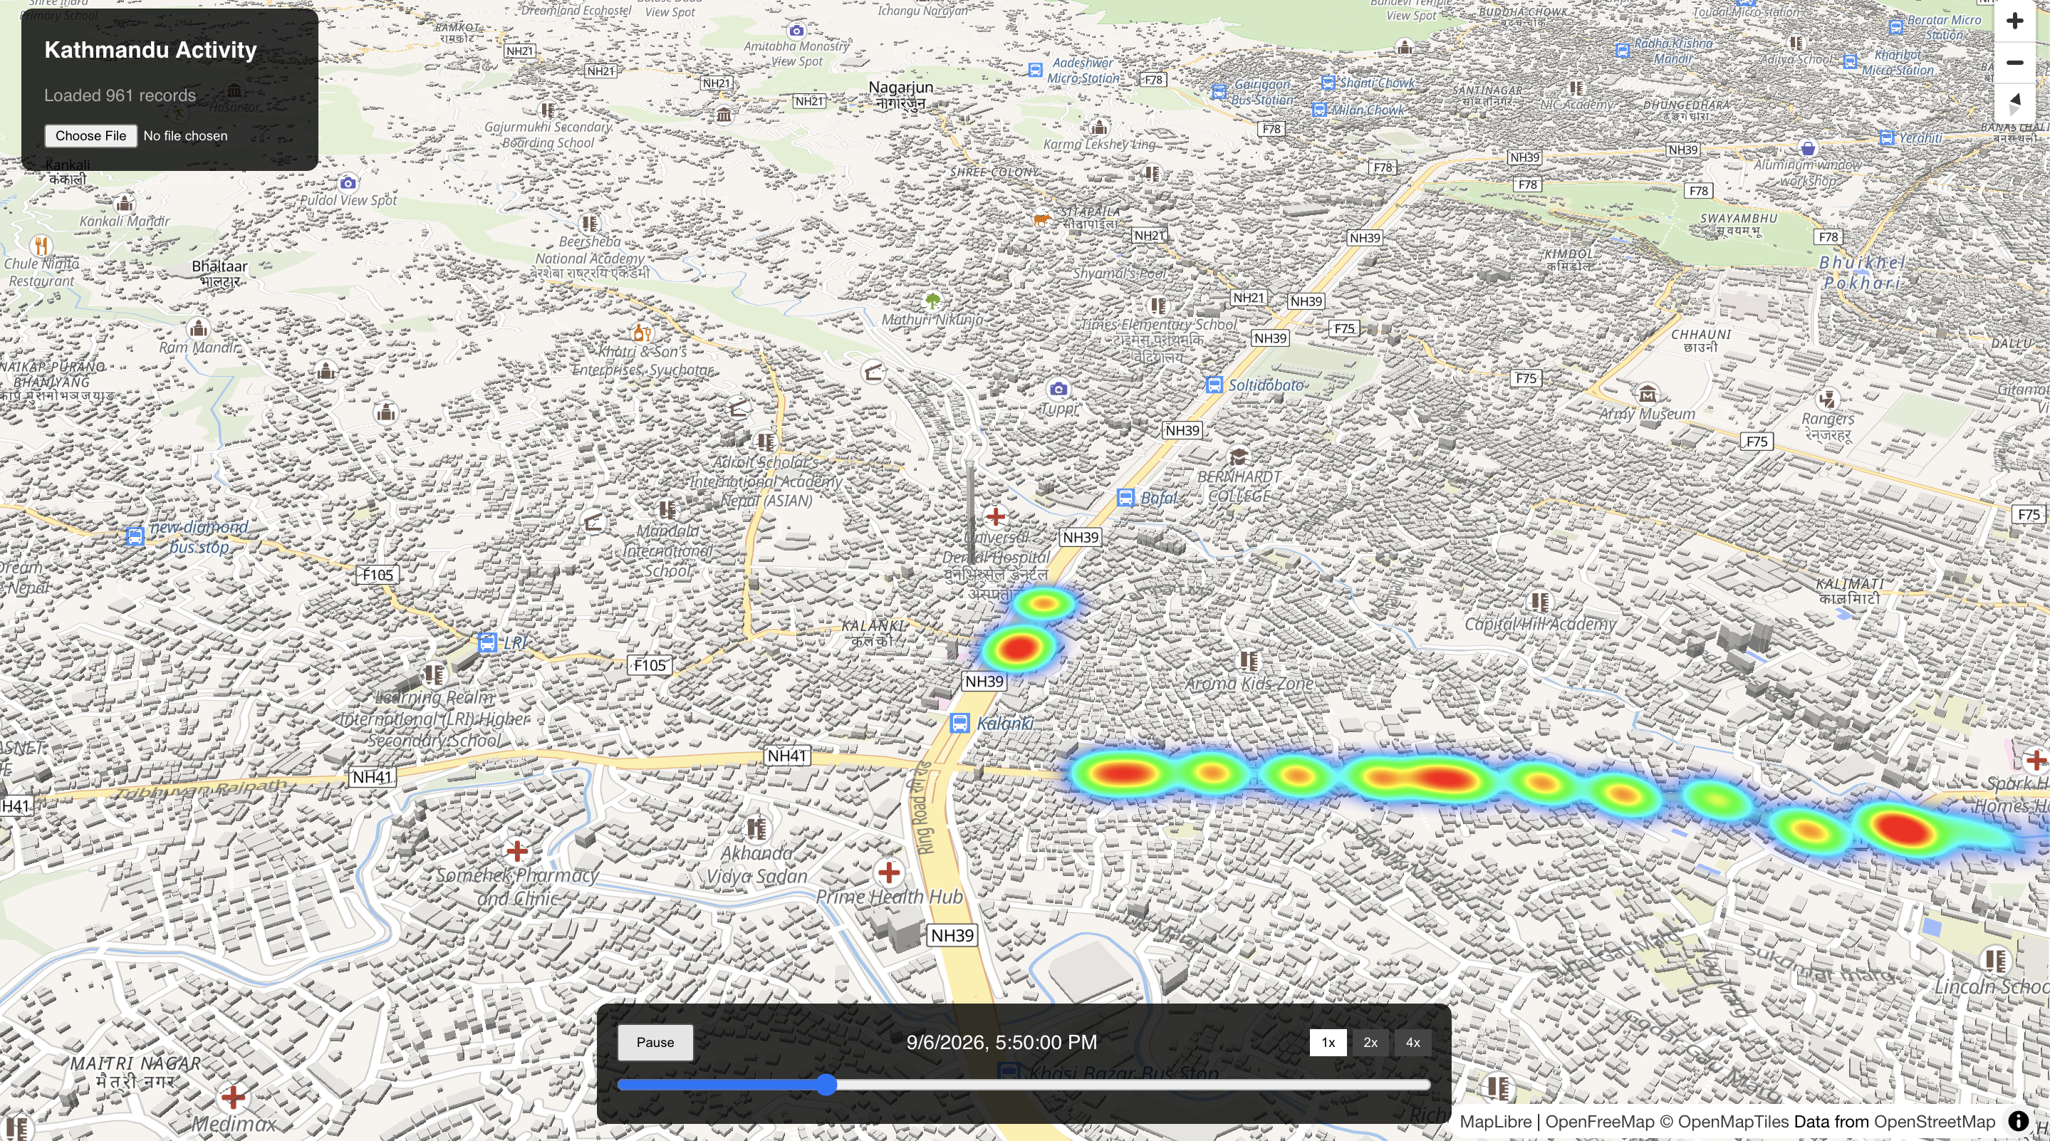

Slide 21
But why did I actually build Spark?
I was called about 4 days before the hackathon saying this is your last semester.
And I usually work as one.
So with the skills I have now I decided to tackle the biggest crisis faced in Nepal.

Slide 22
Spark was meant to be a low cost people finder
But with the limitation of Wifi and Bluetooth. I diverted the methodology to finding the most amount of people as well as where they could have ended up at.
Narrowing down on search time and cost.

Slide 23
SPARK can envisioned to be strapped down to drones who are already great at reconnaissance.
But with the benefit of providing even more workable data and data that can be used for decision making of the highest priority. Heatmaps of lone digital signatures or clusters. Again we’re basing this all on our first assumption.

Slide 24
I do not claim Spark to be a one all solution.
He is a reliable source of knowing digital presence around him and that knowledge is to be used as best to one’s ability.

Slide 25
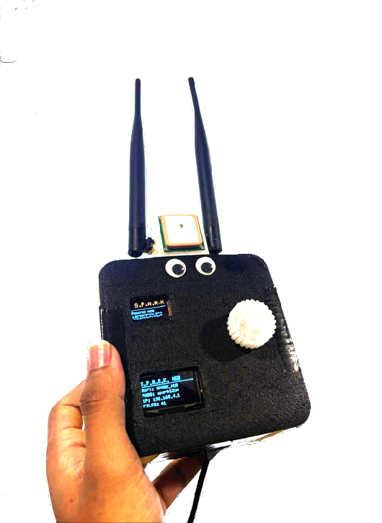
Any Questions?

